Slide 1

Computer Architecture
Course Code: CSE 360
Assoc. Prof. Dr. Ahmed Wasif Reza
Chairperson
Department of Computer Science & Engineering
Tel: +880-2-09666775577 Ext. 221
Email: wasif@ewubd.edu, awreza98@yahoo.com

Slide 2
Lecture 1
Introduction

Slide 3
Computer Architecture
Baer: “The design of the integrated system which provides a useful tool to the programmer”
Hayes: “The study of the structure, behaviour, and design of computers”
Abd-Alla: “The design of the system specification at a general or subsystem level”
Foster: “The art of designing a machine that will be a pleasure to work with”
Hennessy and Patterson: “The interface between the hardware and the lowest level software”

Slide 4
Architecture & Organization 1
Architecture is those attributes visible to the programmer (those attributes that have direct impact on the logical execution of a program)
  Instruction set, number of bits used for data representation, I/O mechanisms, addressing techniques.
  e.g. Is there a multiply instruction?
Organization is how features are implemented (refers to operational units and their interconnections that realizes architectural specifications)
  Control signals, interfaces, memory technology.
  e.g. Is there a hardware multiply unit or is it done by repeated use of the add unit?

Slide 5
Architecture & Organization 2
Historically and still today, the distinction between architecture and organization has been important one.
Many computer manufacturers offer a family of computer models with the same architecture but with differences in organization
A particular architecture may span many years and encompass a number of different computer models, its organization changing with technology
The IBM System/370 family share the same basic architecture since 1970
Over the years, IBM has introduced many new models with improved technology to replace older models, offering the customer greater speed, cost , or both; these newer models retained the same architecture.
The relationship between architecture and organization is very close.
Changes in technology not only influence organization but also introduces more powerful and more complex architecture, e.g., RISC (reduced instruction set computer)

Slide 6
Structure & Function
A computer is a complex system; contemporary computers contain millions of elementary electronic components.
Structure is the way in which the components are interrelated.
Function is the operation of individual components as part of the structure

Slide 7
Function
All computer functions are:
  Data processing
  Data storage
  Data movement
  Control

Slide 8

Functional View

Slide 9
Function (1)
The computer must be able to process data.
-Data may take a wide variety of forms.
-The range of processing requirements is broad.
It is also essential that a computer store data.
-Files of data are stored in a short-term data storage or long term-data storage on the computer for subsequent retrieval and update.

Slide 10
Function (2)
The computer must be able to move data between itself and the outside world.
-The computer’s operating environment consists of devices that serve as either sources or destinations of data. When data are received from or delivered to a device that is directly connected to the computer, the process is known as input-output (I/O), and the device is referred to as a peripheral.
-When data are moved over longer distances, to or from a remote devices, the process is known as data communications.

Slide 11
Function (3)
Finally, there must be control of these three functions.
-This control is exercised by the individual (s) who provides the instructions to the computer.

Slide 12
Four Possible Computer Operations
The computer can function as a data movement device, simply transferring data from one peripheral or communications line to another [See (a)]
It can also function as a data storage device, with data transferred from the external environment to computer storage (read) and vice versa (write) [See (b)]
Final two operations involving data processing either from/to storage or from storage to I/O. [See (c) and (d)]

Slide 13

Operations (a) Data movement

Slide 14
Operations (b) Storage

Slide 15
Operation (c) Processing from/to storage

Slide 16
Operation (d)
Processing from storage to I/O

Slide 17
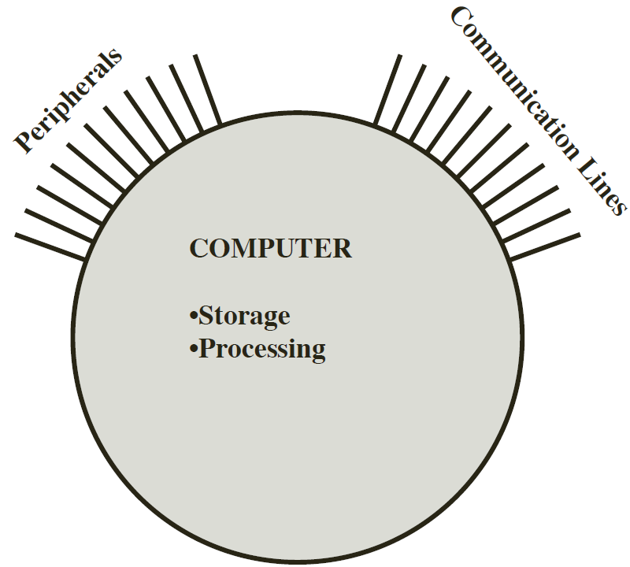
Structure
The computer is an entity that interacts in some fashion with its external environment.
In general, all of its linkages to the external environment can be classified as peripheral devices or communication lines.

Slide 18
Structural Components:
Four main structural components:
Central Processing Unit (CPU): Controls the operation of the computer and performs its data processing functions (referred as processor).
Main Memory: Stores data.
I/O: Moves data between the computer and its external environment.
System Interconnection: Some mechanism that provides for communication among CPU, main memory, and I/O.

Slide 19
Structure - Top Level
Peripherals
Computer
Central
Processing
Unit
Main
Memory
Computer
Systems
Interconnection
Input
Output
Communication
lines

Slide 20
Structure - The CPU
Major structural components are:
Control Unit: Controls the operation of the CPU and hence the computer.
Arithmetic and Logic Unit (ALU): Performs the computer’s data processing functions.
Registers: Provide storage internal to the CPU.
CPU Interconnection: Some mechanism that provides for communication among the control unit, ALU, and registers.

Slide 21
Structure - The CPU
CPU
Computer
Arithmetic
and
Login Unit
I/O
Registers
System
Bus
CPU
Internal CPU
Interconnection
Memory
Control
Unit

Slide 22
Structure - The Control Unit
The most interesting component is the control unit.
The control unit can be implemented using the technique of microprogramming.
Portion of control storage contains microcode.
Micro-operations generally involves a transfer between registers, a transfer between a register and an external bus, or a simple ALU operation.
It causes the processor to execute micro-operations in the proper sequence, determined by the program being executed.
It generates the control signals that cause each micro-operation to be execute.
>>Detailed discussion of control unit will be included in Lecture-12.

Slide 23
Structure - The Control Unit
Control Unit
CPU
ALU
Sequencing
Logic
Internal
Bus
Control
Unit
Control Unit
Registers and
Decoders
Registers
Control
Memory

Slide 24
Lecture Summary
This lecture introduces –
Overall course structure and overview of entire course.
the organization and architecture of the computer.
the structure and function of the computer.

